Slide 1

ARCore

Slide 2


What is ARCore?
SDK (Software Development Kit)
Developed by Google
1 March 2018
Augmented reality applications
Available for both Android and iOS
Support for Unity, Unreal, Android Studio, Xcode

Slide 3
Fundamental Concepts
Motion tracking - track the phone position relative to the world
Environmental understanding - detect the size and location of all type of surfaces: horizontal, vertical and angled surfaces
Light estimation - estimate the environment's current lighting conditions

Slide 4


Motion Tracking
Concurrent Odometry and Mapping (COM)
Visually distinct features in the captured camera image (feature points)
Feature points are used to compute the change in location of the mobile phone.
Inertial measurements from the device's IMU (Inertial Measurement Unit)
Estimation of the pose (position and orientation) of the camera relative to the world over time

Slide 5

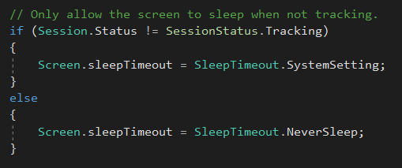
_UpdateApplicationLifecycle()

Slide 6

Environmental Understanding
Constantly improving the understanding of the real world environment
Detection of feature points and planes
Planes: Clusters of feature points that appear to lie on common horizontal or vertical surfaces
Determine each plane's boundary

Slide 7
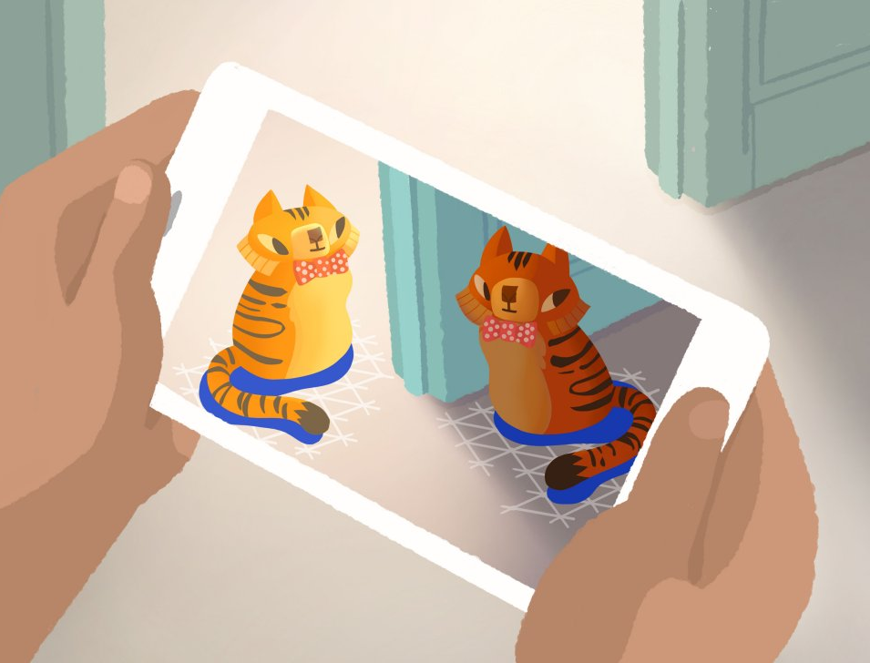
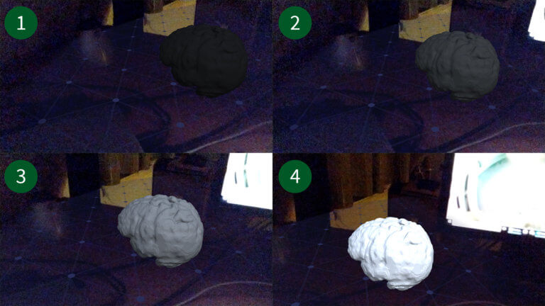
Light Estimation
ARCore can detect information about the lighting of its environment
Average intensity and color correction of a given camera image – PixelIntensity() and ColorCorrection() methods

Slide 8
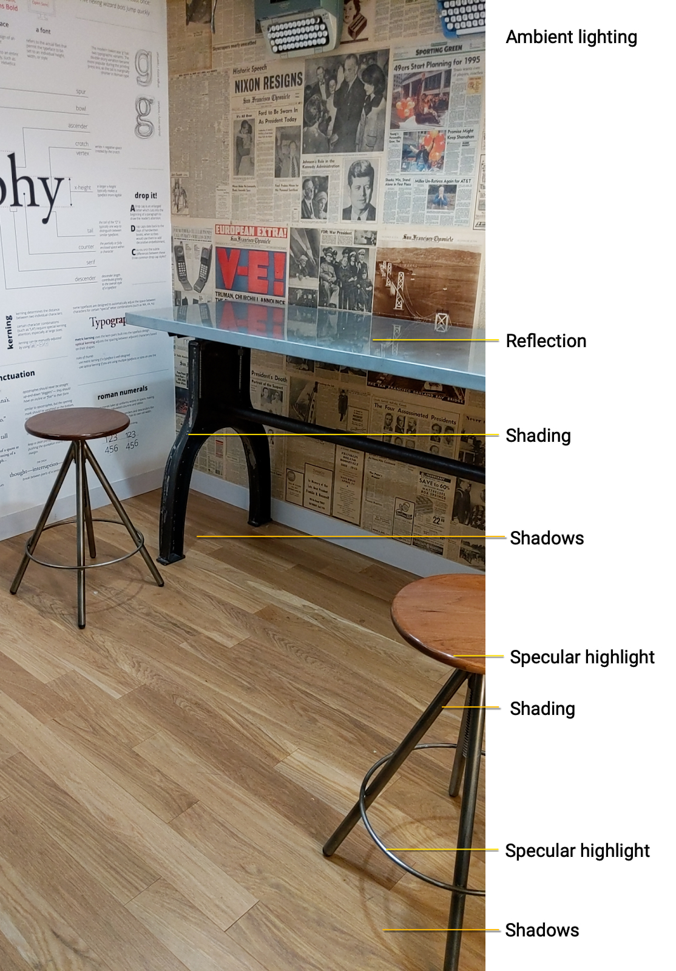
Lighting Cues
Shadows
Ambient Light
Shading
Specular Highlights
Reflections

Slide 9
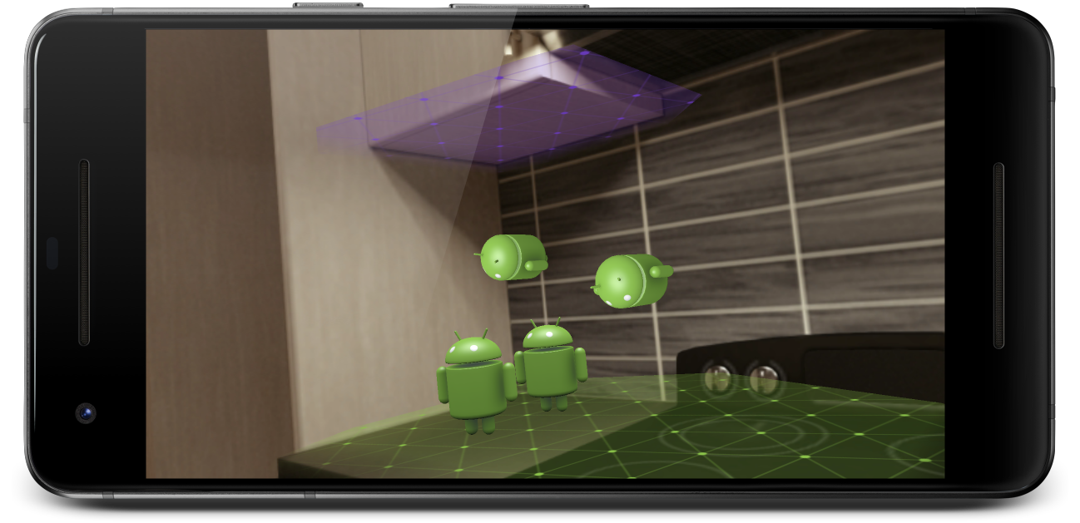
User Interaction
Hit testing to take an (x,y) coordinate corresponding to the phone’s screen
Projection of a ray into the camera's view of the world
Returns any planes or feature points that the ray intersects, along with the pose of that intersection in world space

Slide 10
Oriented Points
Place virtual objects on angled surfaces
Nearby feature points to attempt to estimate the angle of the surface
A pose that takes the angle into account

Slide 11
Anchors and Trackables
Poses can change as ARCore improves its understanding of its own position and its environment
Anchor: Ensuring that ARCore tracks the object's position over time
The fact that poses can change => update the position of environmental objects like planes and feature points over time
Planes and points: a special type of object (trackable) – objects that are tracked over time

Slide 12
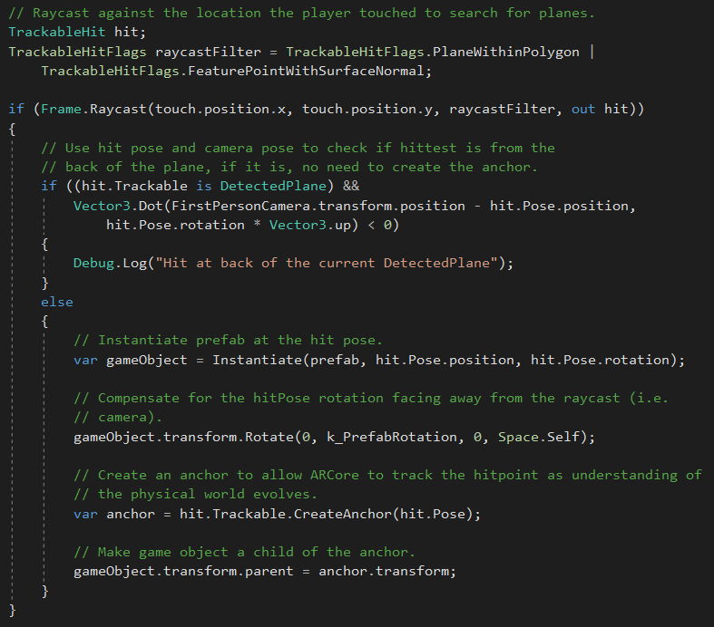
HelloARCore

Slide 13
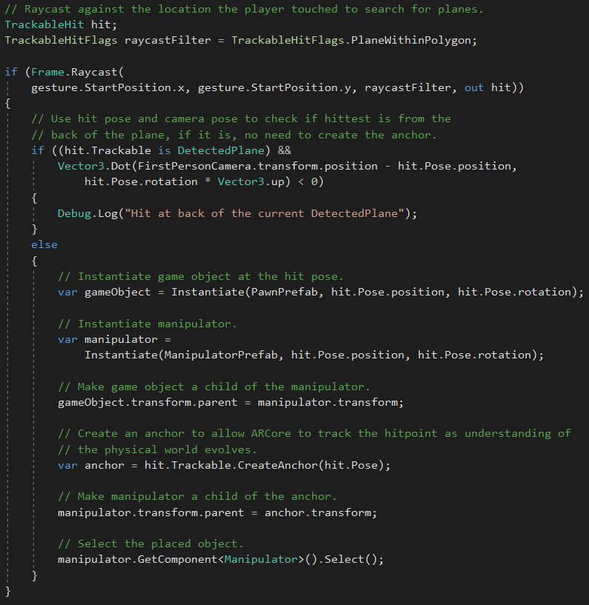
Object Manipulation (1)

Slide 14
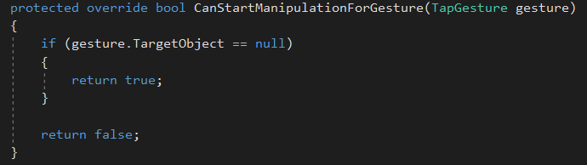
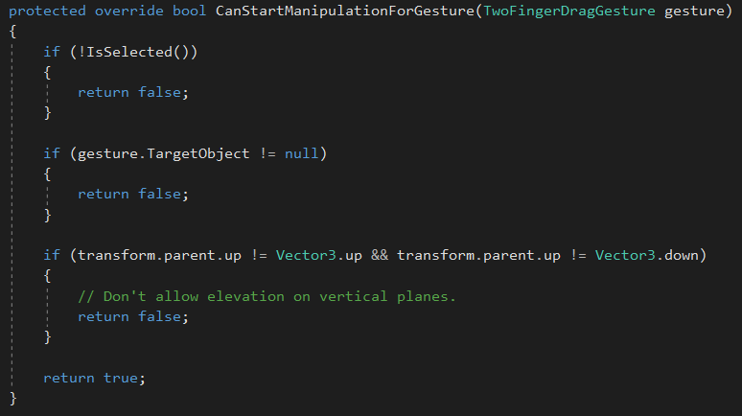

Object Manipulation (2)

Slide 15
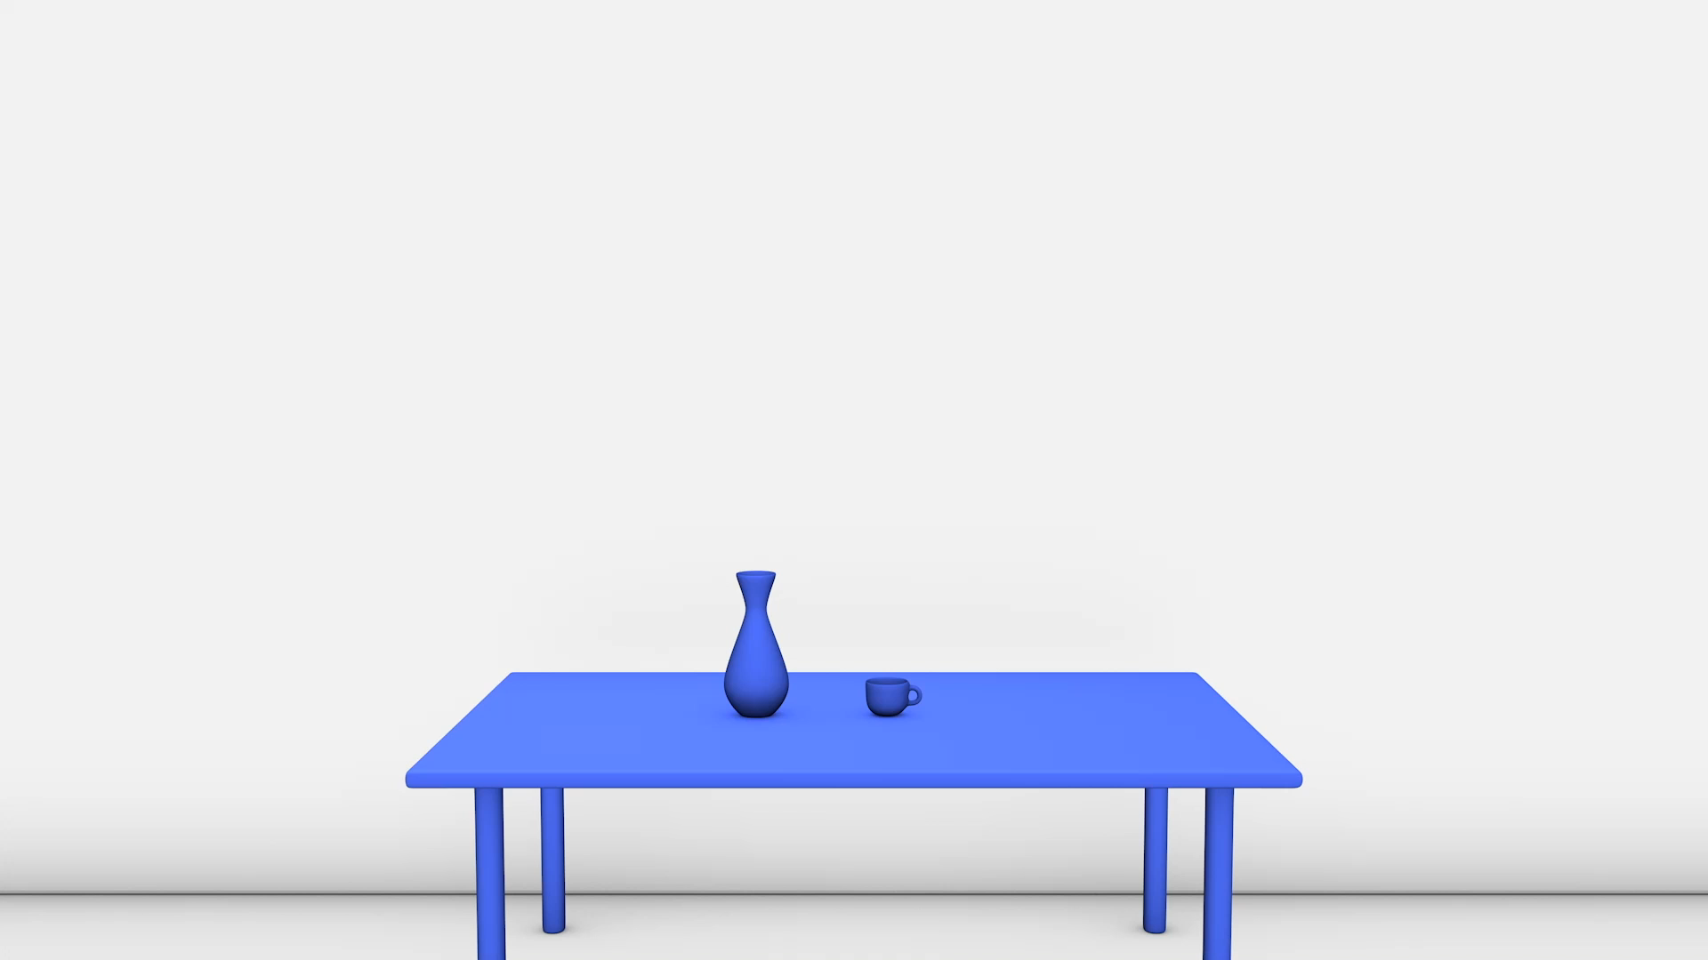
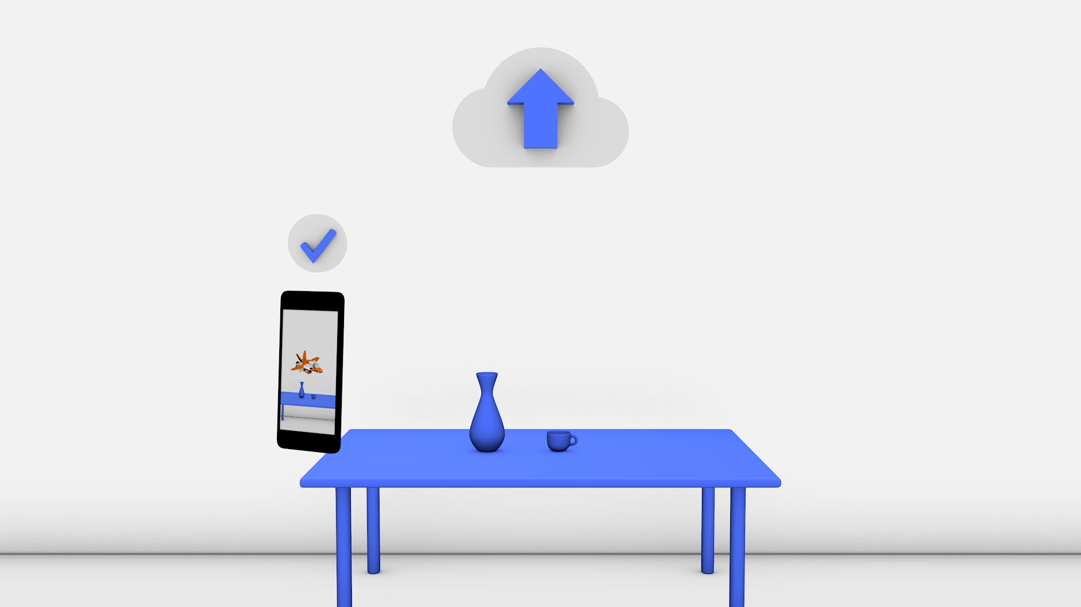
Cloud Anchor
Collaborative or multiplayer apps for Android and iOS devices
With Cloud Anchors, one device sends an anchor and nearby feature points to the cloud for hosting
These anchors can be shared with other users on either Android or iOS devices in the same environment
This enables apps to render the same 3D objects attached to these anchors, letting users have the same AR experience simultaneously.
CreateCloudAnchor(), CloudServiceResponse(), ResolveCloudAnchor()

Slide 16
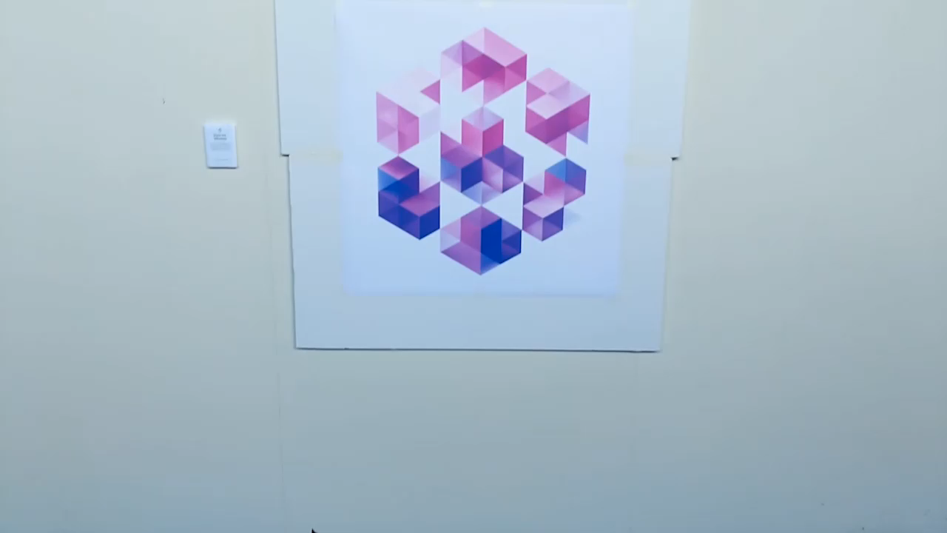
Augmented Images (1)
Apps that can respond to specific 2D images
Users can trigger AR experiences when they point their phone's camera at specific images
Images can be compiled offline to create an image database
Individual images can be added in real time from the device
Once registered, ARCore will detect these images, the images' boundaries, and return a corresponding pose

Slide 17
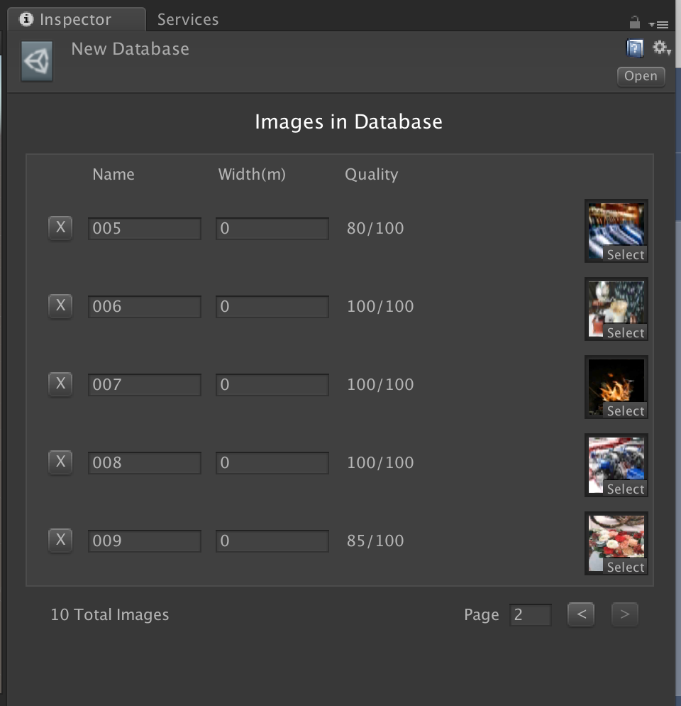
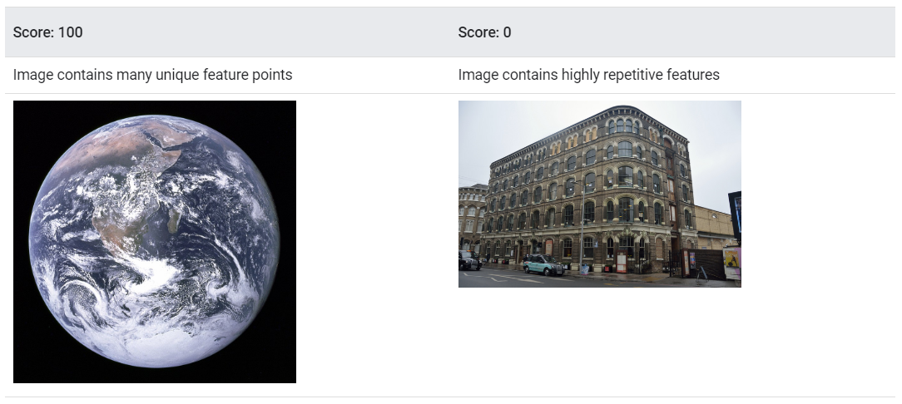
Augmented Images (2)
Track up to 20 images simultaneously
Up to 1000 reference images in the database
arcoreimg: score between 0 and 100

Slide 18
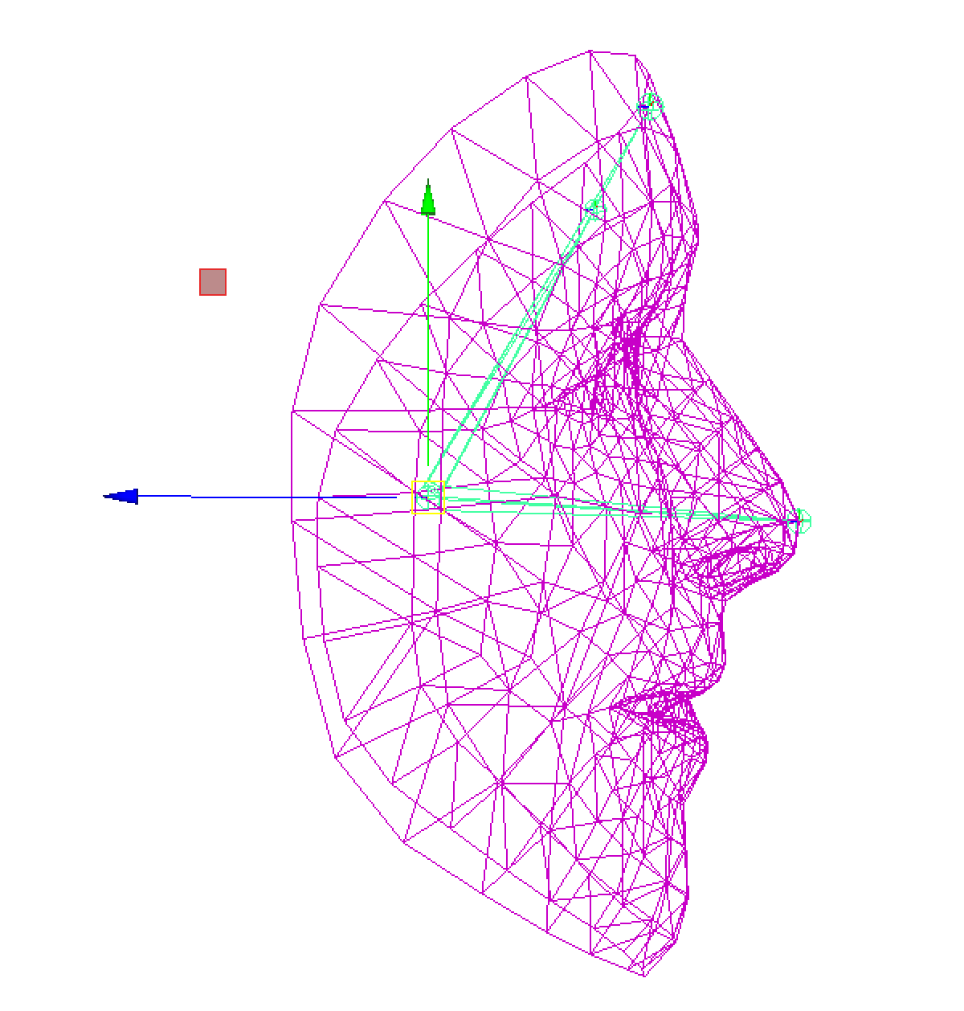
Augmented Faces (1)
Identify the center pose and a face mesh
Identify face region poses on the user’s face:
Left forehead
Right forehead
Tip of the nose

Slide 19
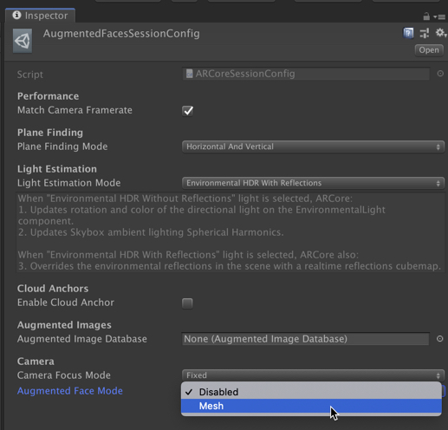
Augmented Faces (2)

Slide 20

Known Issues
Detecting planes is sometimes annoying
The detected planes are sliding away
Feature points for plane detection => flat surfaces without texture, such as a white wall, may not be detected properly
Not all devices support ARCore

Slide 21

AR Foundation

Slide 22


ARCore Issue

Slide 23
AR Foundation
A cross-platform framework
Build augmented reality experiences for either Android or iOS devices
A default version of AR Foundation is automatically installed along with the ARCore Extensions for AR Foundation SDK

Slide 24
Useful Links
https://developers.google.com/ar/develop/unity/quickstart-android
https://developers.google.com/ar/discover/supported-devices
https://developers.google.com/ar/develop/unity/tutorials/hello-ar-sample

